Slide 1

HOME AUTOMATION AT A CLICK USING IOT
Group No. 16
Akhil Jain 18204005
Saunvid Ganbavale 17104052
Sagar Gabre 18204011
Project Guide and Co guide
Prof. Uttam Kolekar
Prof. Kiran Deshpande

Slide 2
Introduction
Home automation or domotics is building automation for a home, called a smart home or smart house.
A home automation system will control lighting, entertainment systems, and appliances. It may also include home security such as access control and alarm systems.
When connected with the Internet, home devices are an important constituent of the Internet of Things ("IoT").

Slide 3
2.Objectives
The objective of this project is to implement a low cost, reliable and scalable home automation system that can be used to remotely switch on or off any household appliance, using a phone to achieve hardware simplicity.

Slide 4
2.1 Outcome
Identification.
Comfort.
Reliability.
Full control over home appliances

Slide 5
3.Problem Definition
Conventional wall switches are located in different parts of a house and thus necessitates manual operations like to switch on or off these switches to control various appliances. It gets virtually impossible to keep track of appliances that are running and also to monitor their performances.
Home automation provides security, energy efficiency and ease of use hence, it is adopted more.
It also provides remote interface to home appliances to provide control.

Slide 6
4.Technological stack
I.SOFTWARE REQUIREMENTS
1. ARDUINO
2. ANDROID STUDIO
II.HARDWARE REQUIREMENTS
1.ARDUINO UNO/BT Module
2.RELAYS
3.FINGERPRINT SCANNER
4.SERVOS AND MOTORS

Slide 7
5.Review Suggestion
To implement security in the system(Hash algorithm)
A hash algorithm is a function that converts a data string into a numeric string output of fixed length. The output string is generally much smaller than the original data. Hash algorithms are designed to be collision-resistant, meaning that there is a very low probability that the same string would be created for different data.

Slide 8
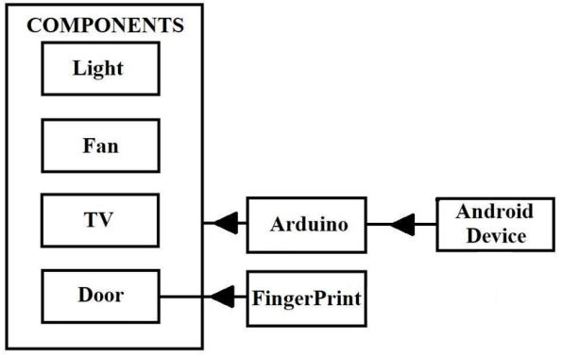
6.Proposed system architecture
fig.1

Slide 9
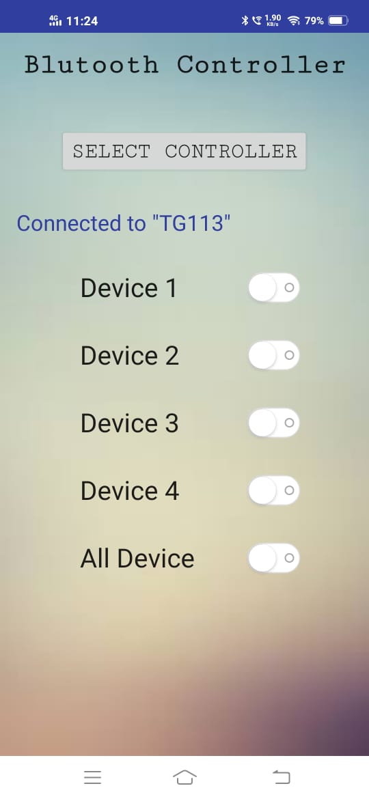
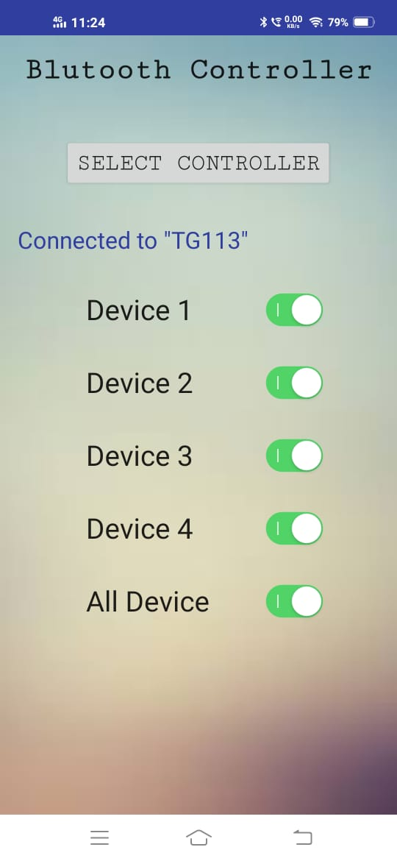
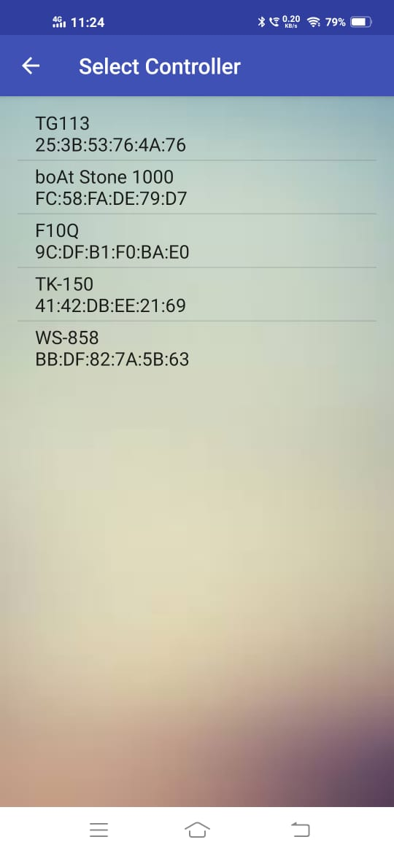
7.Prototype Design Demonstration
fig.2

Slide 10
8.CONCLUSION
The home automation App using Android been experimentally proven to work satisfactorily by connecting simple appliances to it and the appliances were successfully controlled remotely through an Application. Home Automation is undeniably a resource which can make a home environment automated. People can control their electrical devices via these Home Automation devices and set up controlling actions through Mobile.

Slide 11
THANK YOU

